Slide 1
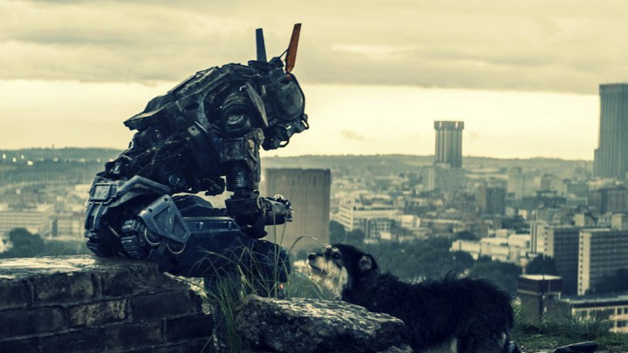
Artificial Intelligence
Notes:
What are thoughts or ideas of artificial intelligence?
Driverless cars
Home automation
Face recognition
Computer vision
Speech translation
Sentiment analysis
Search
Language understanding
Algorithmic trading
Automotive robotics
Online assistances / chat bots
Handwriting recognition
Chappie – modern day Robocop

Slide 2
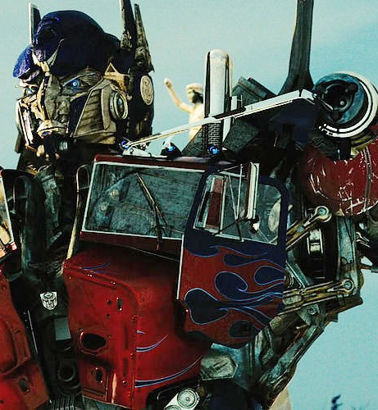
What is Artificial Intelligence
Three types of Artificial Intelligence
Weak AI
Strong AI
Super Intelligence
Machine learning provides the foundation for artificial intelligence
Technique used to train a model using data for predictions
Three main types of Machine Learning
Supervised
Unsupervised
Reinforcement
Notes:
Intelligence displayed by a machine or software.
Large fields of ongoing research to expand areas of interests.
Weak AI – non-sentient machine intelligence, focus on a narrow task.
Strong AI or general intelligence to apply intelligence to any problem rather than one specific
Super intelligence – surpassing humans intelligence with any problem
“Learning” - progressively improve performance on a specific task
Supervised learning maps input to output based on input-output pairs.
A mathematical function is inferred from labeled training data.
Then new data can be entered into the function to calculate a prediction.
Linear regression
Unsupervised learning similar to supervised learning but the training data is not labeled.
The areas of usage are clustering and anomaly detection.
Reinforcement learning
Environment – State - Agent – Action – New State
Algorithmic trial and error
Software agents take actions in an environment to maximize reward.
Swarm intelligence or simulation-based optimization.
Based on Markov decision process from the 1950s
Pacman – Go – Atari games

Slide 3
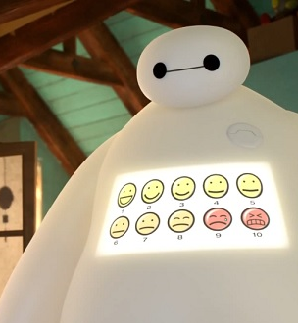
Data Quality in Medical Imaging
According to a 2012 report, the annual cost of medical errors in the United States in 2008 alone was $19.5 billion.
Some of these errors are very hard to prevent without massive overhauls of operational process and organizational culture. But some errors could be easily flagged for human review using artificial intelligence.
Notes:
How can AI be applied to this issue?
One area is in CT Scans.

Slide 4
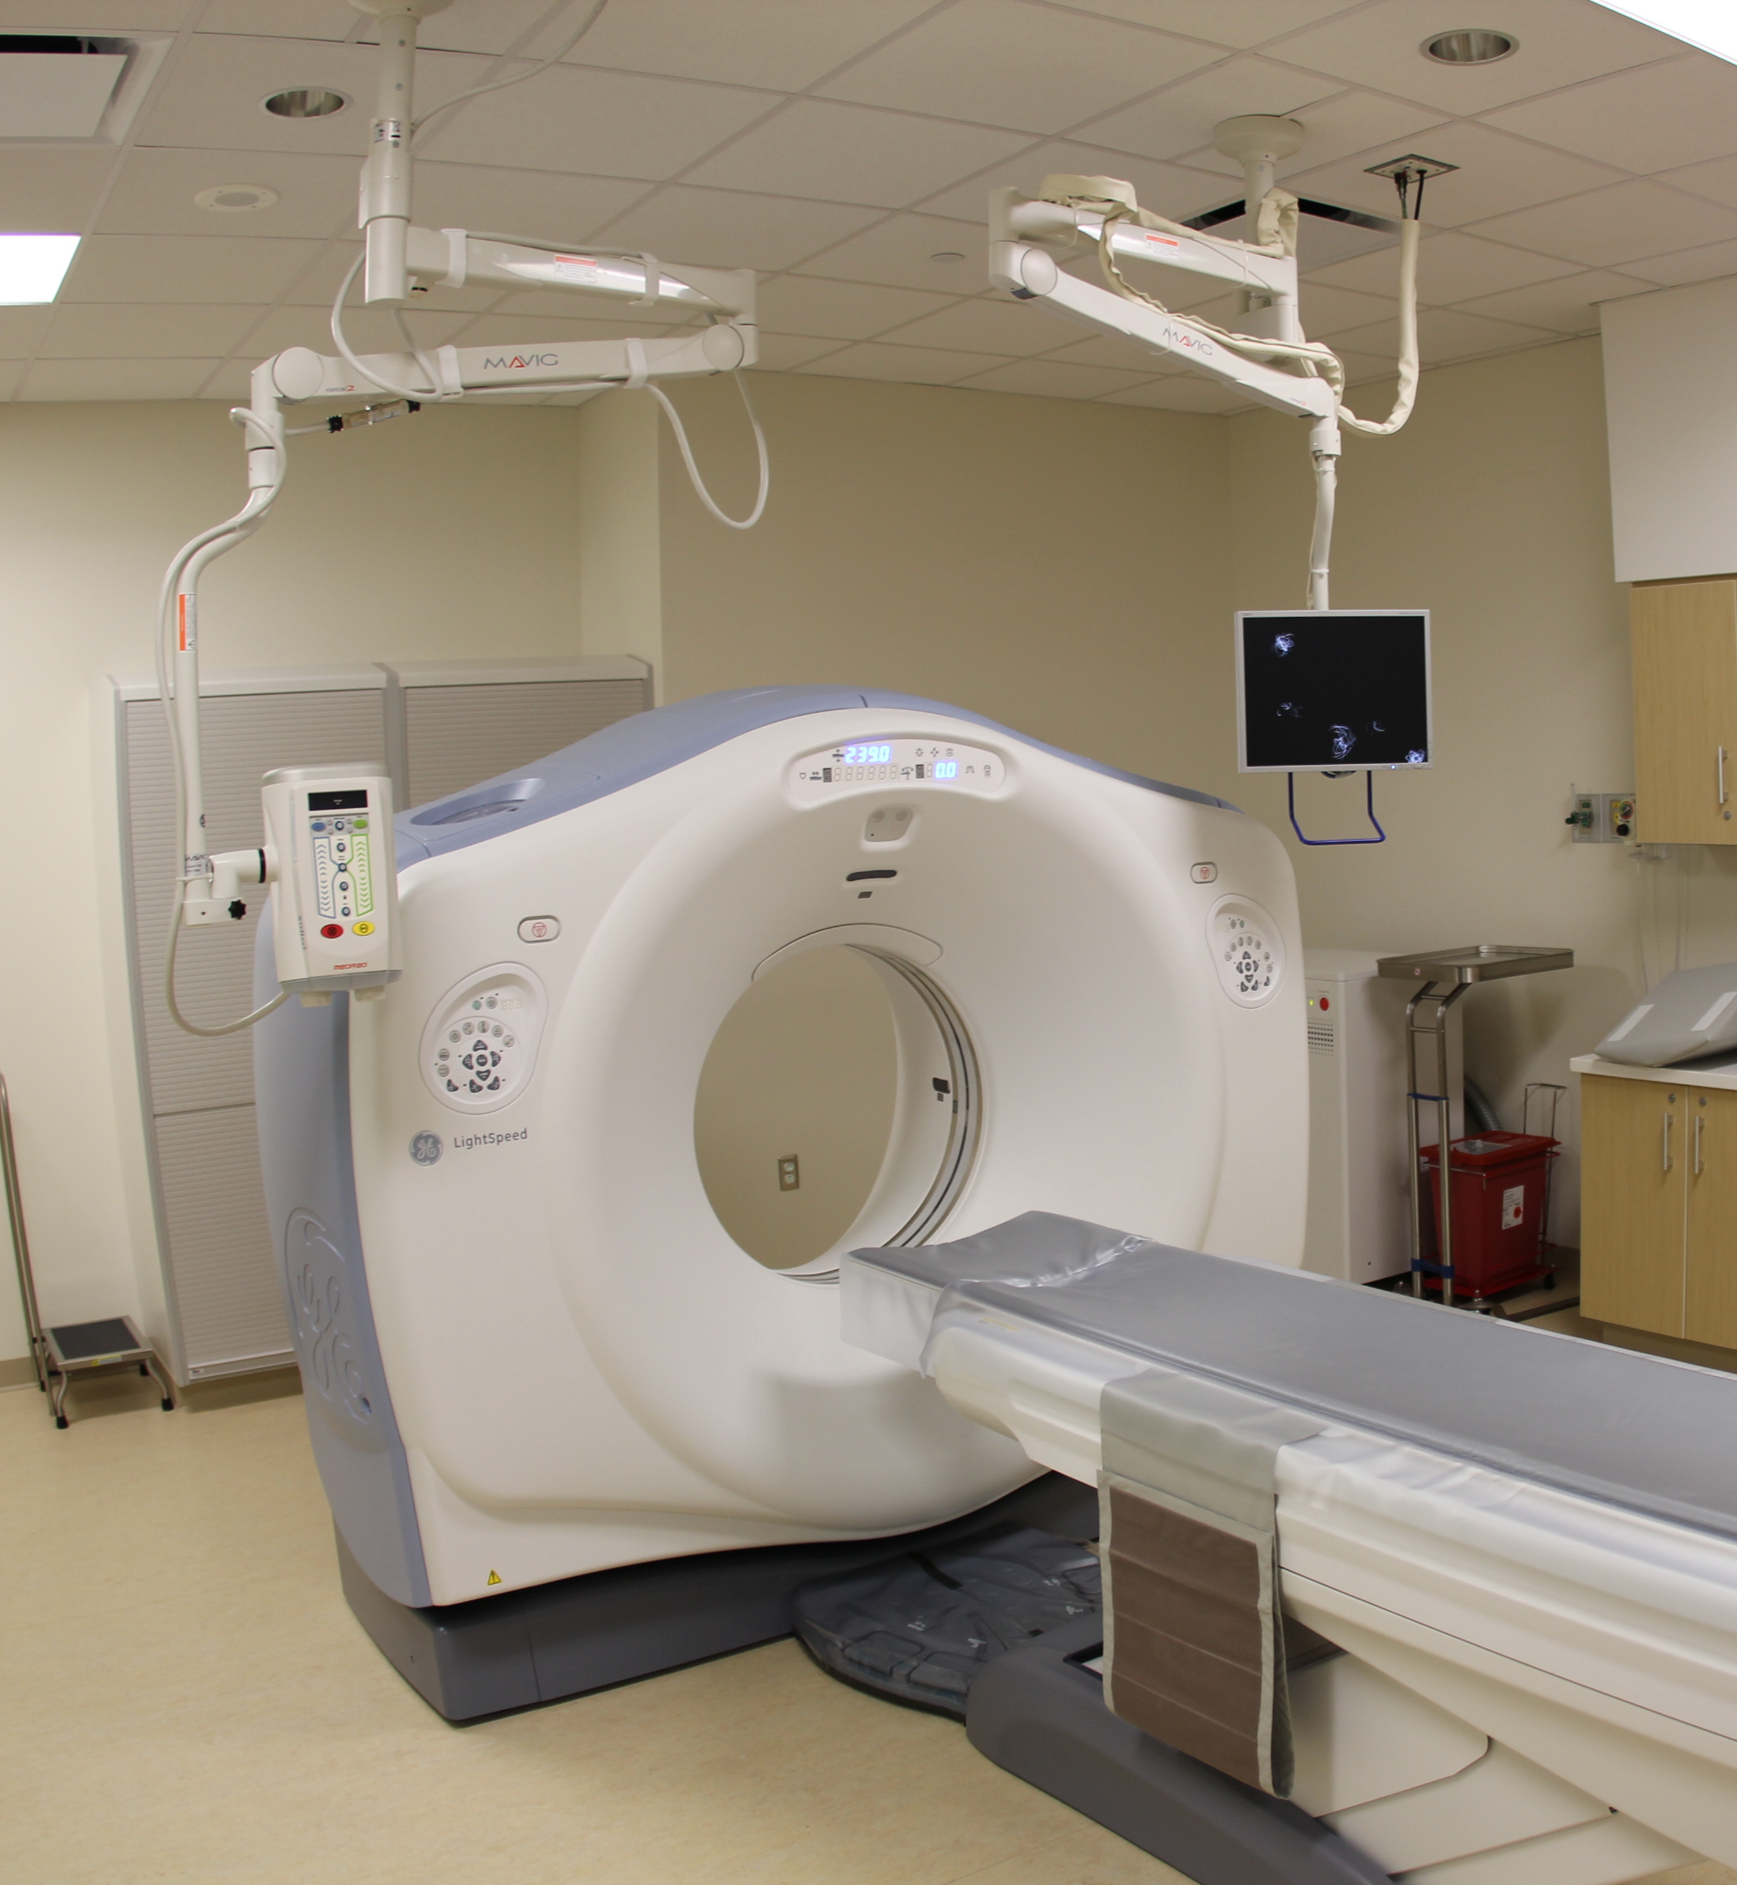
Background on CT scans
When a patient has a CT scan taken, a special devices uses X-rays to take measurements from a variety of angles which are then computationally reconstructed into a 3D matrix of intensity values. Each layer of the matrix shows one very thin "slice" of the patient's body.
Notes:
Computed tomography scan
Tomography is imaging by sections or “slices”
With a CT scan there is data collected and saved for future review.
One of the fields from the scan is important to the orientation of the patient.

Slide 5
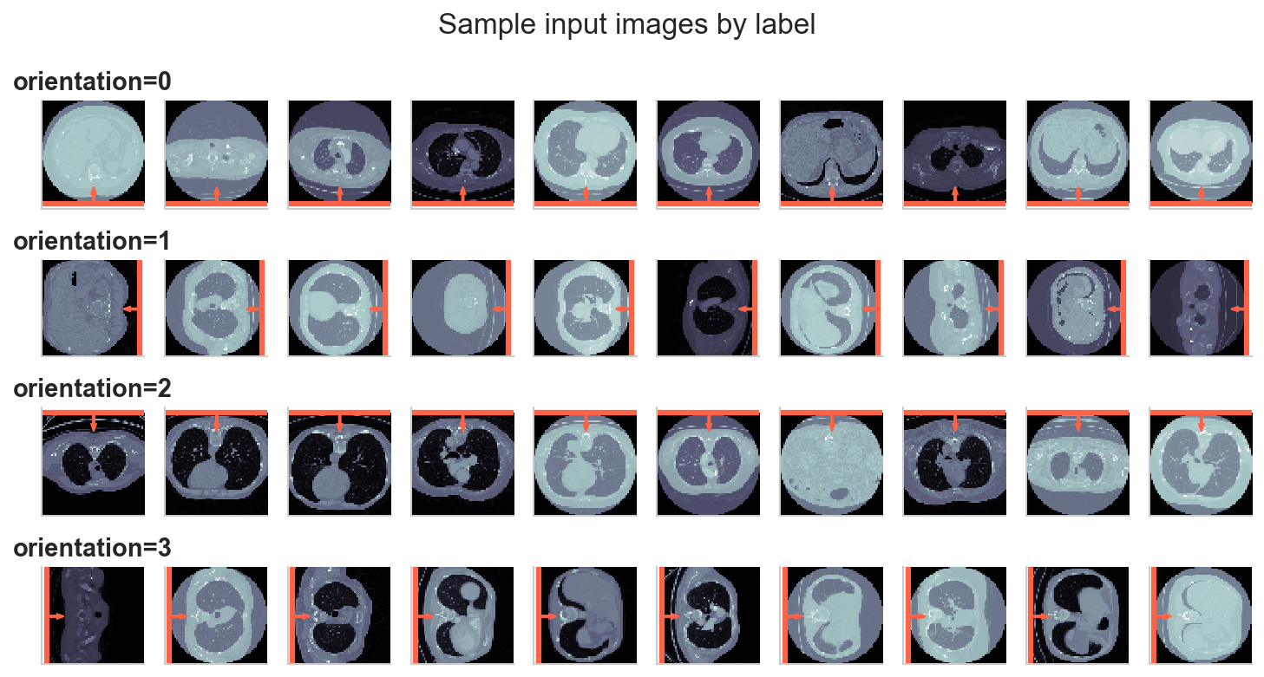
Problem Statement
We want to improve the error checking for one single but incredibly important value: a field known as Image Orientation (Patient) which indicates the orientation of the patient's body in the image.
0: Spine at bottom, patient facing up.
1: Spine at right, patient facing left.
2: Spine at top, patient facing down.
3: Spine at left, patient facing right.
Notes:
Having this orientation will help doctors or surgeons make a decision on the location of interesting areas of the patient.
We now have a problem to address, but we need a data set to train our model.
Then once trained, we can predict the orientation of a patient without human intervention.

Slide 6
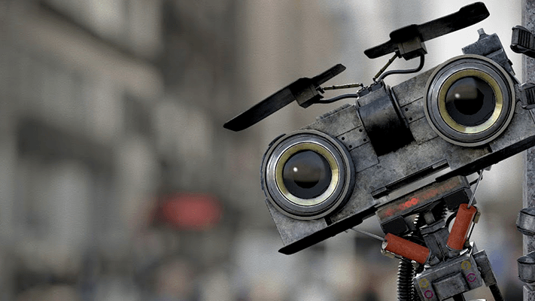
INPUT Data Set
The Lung Image Database Consortium image collection (LIDC-IDRI) consist of diagnostics and lung cancer screening thoracic CT scans.
Train folder contains images along with a csv of labels and file names.
Test folder contains images that needed to be labeled.
Each folder contains 20K images for 40K images total.
Each image was 64 x 64 pixels and was 156 MB total.
Notes:
We have our problem statement and data set.
Now we need a solution to process and predict the patient orientation.

Slide 7
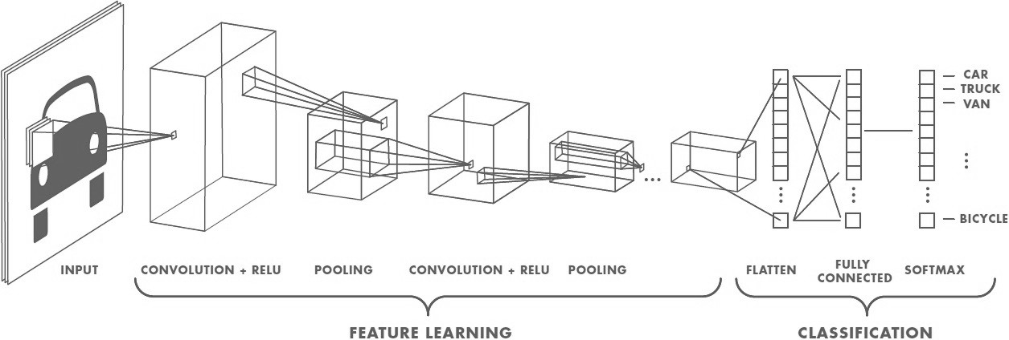
Convolutional Neural Network
Notes:
Neural Network is a collection of neurons that mimic a biological brain.
Each synapses transmit a signal from one neuron to another.
Each neuron then receives a signal and processes it to each connected neuron.
A convolution is an operation in which two functions that produce a third function to expresses how the shape of one is modified by the other.
Riding a bicycle and a wind gust alters your course. The forces that create the resulting path are the convolution of your bicycle drift.
Relu is an activation function that defines the output of the convolution.
An activation function is the weighted sum of the inputs and adds a bias on whether or not it should be “fired” or not.
Similar a neuron, if we visually see an object, the neurons in our brain recognize and “fire” that this is similar to a previously seen object.
Relu is the most popular in deep learning.
Pooling reduce the number of parameters and overfitting.
Max or Average pooling will take the value of a convolution region and set it as the output
Flatten / Dense layer changes the input shape to a simple vector output.
This vector contains all the found features of the previous layers.
Fully connected layers establishes links between every neuron in the flattened layer to every neuron in the previous layer.
This layer performs the high-level reasoning in the neural network.
Softmax function is used to squash the fully connected layer of features into a categorical distribution.
Does this identified feature look similar to Car, Truck, Van, or Bicycle?
The more features that match, the higher the chances of categorizing the image
We have our problem statement, data set, and solution.
Now we need to process the data.

Slide 8
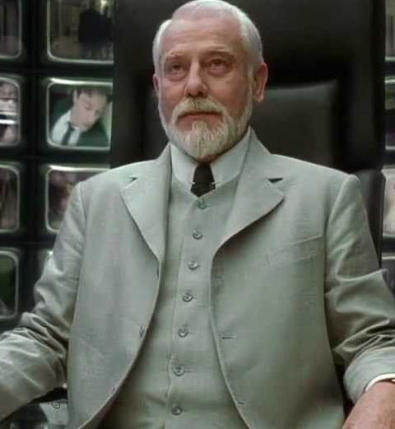
Tools and Software
Visual Studio Code
SQL Operations Studio
Microsoft Cognitive Toolkit (CNTK)
Keras
Anaconda / Python

Slide 9

Model Training and Hardware
Intel i7-7700HQ @ 2.80 GHz / 4 cores
40 minutes per epoch
100 epochs = 6 hours
Notes:
We have our problem statement to identify the orientation of a patient
We have input
We have a method to identity the orientation
Now we need software and hardware to process the images
Deep Learning Epoch is a single pass through the training set
“Learning” - progressively improve performance on a specific task
We have our problem statement, data set, and solution.
We need better hardware.

Slide 10
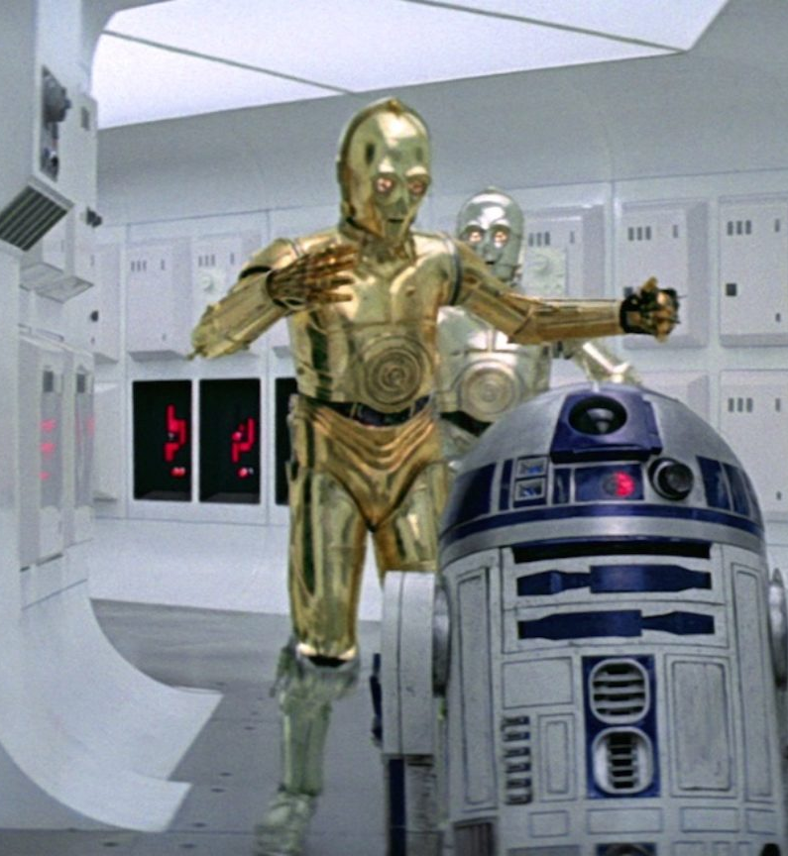
Graphics Processing Unit
Hundreds of CPUs on a chip
Highly effective multithreading
NVIDIA GeForce GTX 1070
Pascal Architecture with 1,920 cores
10 seconds per epoch
100 epochs = 16 minutes
22.5% increase
Demo
Keras with CNTK
Notes:
Maxwell – 28 nm / Pascal – 16 nm
Jun 10, 2016, 2 years
Turning architecture – Aug 30, GTX 1180
Nvidia’s GeForce GTX 1180 is rumored to
include 3,584 CUDA cores – same as the current 1080 TI
clock speed between 1.6 and 1.8GHz – 1.5 current 1080 TI
and 16GB of GDDR6 memory – 11GB GDDR5X current 1080 TI
Gamescom – August 20 rumored to release info
Email on August 1 – GeForce NOW online game streaming service similar to Netflix for Stream
Other mfgs include AMD and Intel

Slide 11

Microsoft Professional Program
academy.microsoft.com
Artificial Intelligence
Big Data
Data Science
Cloud Administration
DevOps
Front-End Web Development
IT Support
Entry Level Software Development
Notes:
Online certification program in partnership with edX.
MOOC Massive Open Online Courses
The program started in 2016 and has expanded to the eight listed.
AI and Entry Level Software Development were added in April 2018.
Each track has 8 – 10 courses and each course generally takes 8 to 12 hours to complete.
Each course length varies from 4 weeks to 12 weeks depending on the topic or partner program.
Verified certification is available to purchase after successfully completing each course.
Each course is set up to be repeatable and some can be taken at anytime.

